Slide 1
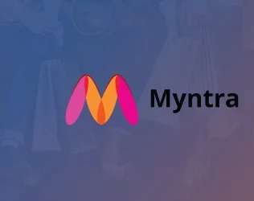
Myntra Analysis
Domain:
E-commerce
Fashion and Apparel

Slide 2
Introduction to Myntra
Myntra is one of the largest fashion eCommerce stores in India that deals with a wide range of products for men, women, and kids.
Established in 2007 by Vineet Saxena, Ashutosh Lawania, and Mukesh Bansal.
Headquartered in Bangalore, Karnataka, India.
Flipkart has been the parent company of Myntra since 2014 .

Slide 3

Mission and Vision
Myntra's mission and vision are to provide "a hassle-free and enjoyable shopping experience to shoppers across the country with the widest range of brands and products on its portal”.

Slide 4
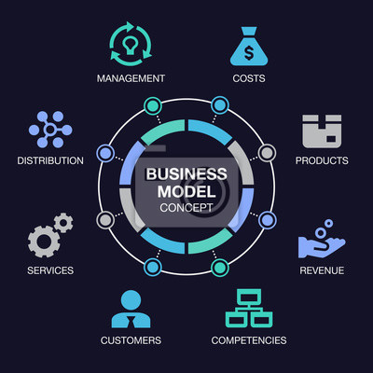
Business Model
Between 2007 and 2010, Myntra concentrated on B2B sales of customizable gift goods that could be ordered on demand.
Myntra has then adopted an aggregator business model, facilitating direct consumer-brand connections (B2C).
Myntra appeals to young and old Indians, with a special focus on Gen Y, or the millennials, and Gen Z.
Myntra currently operates with 1,001–5,000 employees.
The company has over 6,000 brands as of March 2024.
Myntra typically lists around 500,000+ products across its website and app.

Slide 5

Myntra’s Market Position and Growth Journey
Initially focused on personalized gifts (T-shirts, mugs, etc.).
Pivoted to fashion and lifestyle products by 2011, partnering with leading brands.
Acquired by Flipkart in May 2014 for approximately $300 million.
Become the largest online fashion retailer in India. Competing with Jabong, Amazon Fashion and Ajio.
Partnered with 3,500+ brands (national and international)
During pandemic increased penetration in tier 2 and tier 3 cities
After pandemic focus on private labels like roadster, HRX and other for better margins.

Slide 6
Myntra’s Market Position and Growth Journey
It has 60 million average users as of March 2024
It has 75 million new app users as of December 2023
The company has over 6,000 brands as of March 2024
It has delivered to over 19,000 pin codes across India as of March 20
Recognising the importance of omnichannel retailing, Myntra expanded its presence offline through initiatives like Myntra Studio.

Slide 7
Myntra’s Phenomenal Growth and Customer Expansion
“We’ve had a phenomenal year and are proud of the efforts put in by the teams along with brands. We’ve added the highest number of new users and new customers this year, whilst doubling our loyal customer base,” said Sunder Balasubramanian, Chief Marketing Officer at Myntra.
“It’s been heartening to see how multifaceted our growth has been. In our commitment to provide a delightful shopping experience to customers, we continue to make several strides and achieve major milestones,” commented Balasubramanian, on customer expansion and growth.

Slide 8

Myntra Financials FY22 FY23 - Revenue
Operating Revenue | INR 3501.2 crore | INR 4375.3 crore
Total Expenses | INR 4206.9 crore | INR 5290.1 crore
Cost of Material Consumed | INR 1770.3 crore | INR 2165.7 crore
Employee Benefit Expenses | INR 522.5 crore | INR 631.8 crore
Advertising Expenses | INR 1298 crore | INR 1758.8 crore
Net Loss/Profit | Loss of INR 597.6 crore | Loss of INR 782.4 crore

Slide 9
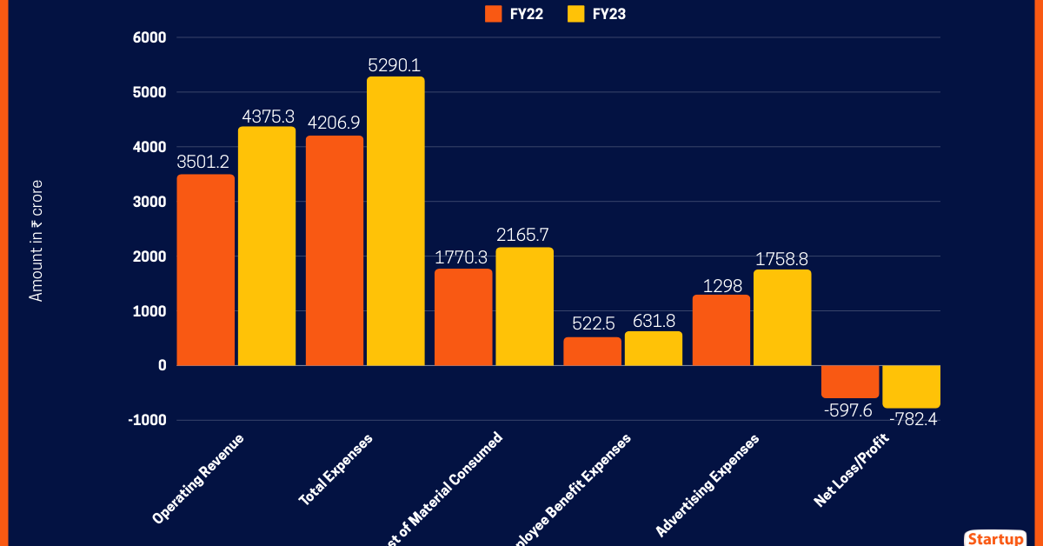
Myntra Financials FY22 FY23 - Revenue

Slide 10
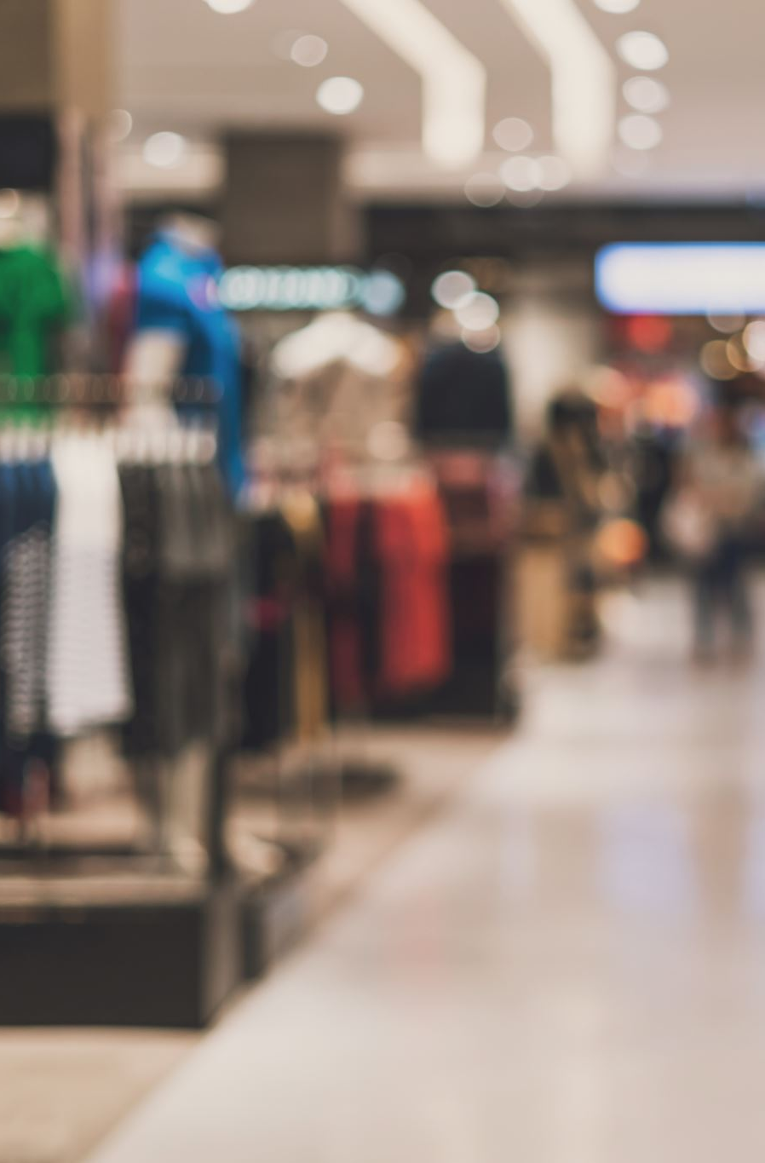
Market Position and Challenges
50% market share in India's online fashion sector.
20+ million monthly active users.
Revenue surpassed $1 billion in 2022.
Expanding reach in both metro and non-metro cities.
Emphasis on adapting to sustainability trends and evolving consumer behavior.

Slide 11

Leveraging Technology for Operational Excellence at Myntra
AWS Power:
EC2: Automatically scales during peak traffic for smooth shopping.
Data insights: Tools like redshift & Athena optimize inventory and customer patterns.
AL & ML: SageMaker enhances recommendations and search for personalized shopping.
Myntra FWD & ML Impact:
FWD Platform: Engages customers and upskills fashion creators.
Smart Personalization: Boosts sales with tailored experiences and trend creators.
Efficient Automation: Streamlines support and operations, cutting costs and improving customer satisfaction.

Slide 12
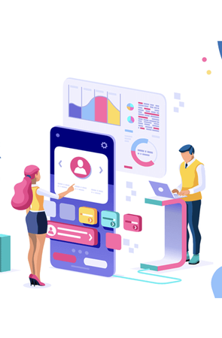
Positive Sentiment analysis
Excellent product quality and variety.
User-friendly website and mobile app.
Fast and reliable delivery service.
Personalized shopping experience.
Vast Product Selection & Trend Alignment

Slide 13

Negative sentiment analysis
Quality Concerns with Low-Cost Items
Wrong or Defective Products
Poor quality or misleading product descriptions.
Delayed deliveries and order fulfillment issues.
Inadequate resolution for complaints or issues.
Customer Service Issues

Slide 14
Mixed Sentiment Analysis
Average customer service experience.
Some issues with product sizing and fit.
Mixed experiences with returns and exchanges.

Slide 15
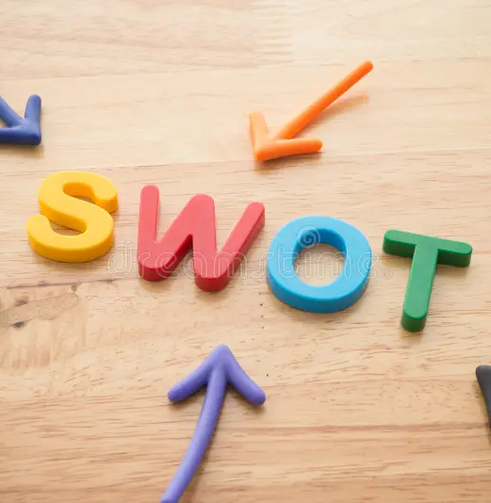
SWOT Analysis
Strengths: Diverse product range, Strong Personalization, Data-Driven Insights, User Friendly interface, Reputation for Quality.
Weaknesses: Intense competition, Return and Exchange Processes, Customer Service Challenges, Sizing and Fit Issues.
Opportunities: Technology integration, sustainable fashion, regional and rural expansion, Growth in E-Commerce, Enhanced Influencer Collaborations.
Threats: Regulatory challenges, changing fashion and consumer preferences, economic fluctuations, data privacy concerns, global competitors.

Slide 16
Strategic Recommendations
Offer customizable clothing options for certain products during special events to stand out.
Collect customer surveys to maintain regular engagement and improve operations.
Enhance customer service with quick responses and issue resolution to build trust and satisfaction.
Provide personalized fitting solutions and detailed brand size charts to address fit complaints.
Strengthen influencer campaigns, omnichannel experiences, and data-driven advertising for personalized engagement.

Slide 17

Summary
Myntra leads in fashion e-commerce with a focus on personalized shopping, influencer marketing, and market expansion.
AI/ML powers personalized recommendations, customizable clothing, and innovations like visual search and voice commerce.
Emphasizes personalization, feedback surveys, faster service, and fit solutions to enhance satisfaction and loyalty.
Strong in technology and loyalty, with opportunities in private labels and new markets; business model includes exclusive collections and loyalty programs.
Offer customizable products, gather feedback via surveys, improve service, and focus on sustainability and influencer marketing to stand out.

Slide 18
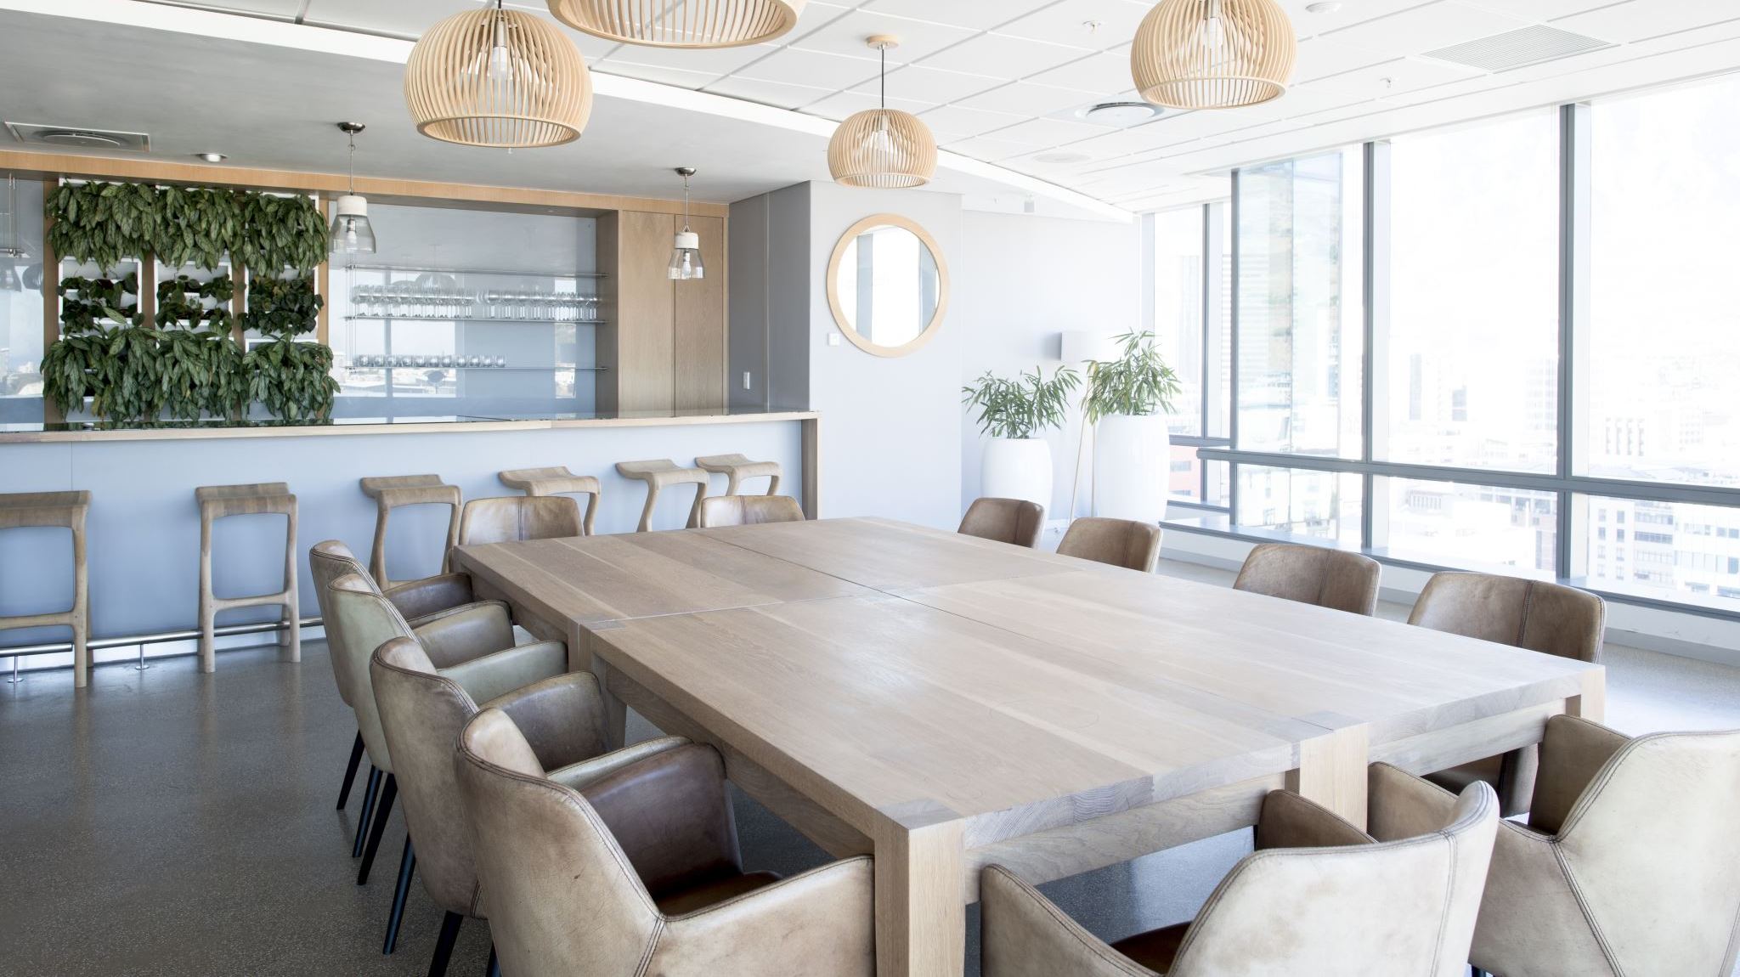
Thank you

